Slide 1
UE18CS348 Human Computer Interaction Hands-free
Team Members :
Alluri Nayan Varma - PES1201800208
Akhil Chaduvula - PES1201800282
Thota Saran Sai - PES1201800845

Slide 2
INDEX
What is Hands-free
Problem Statement
Low Fidelity Diagram
High Fidelity Diagram
Heuristic Evaluation
Empathy Map

Slide 3
What is Hands-free (Gesture Based mouse cursor Control)?
This application uses gestures from the face to control a the computer mouse
It recognises any face and uses gestures from to take the corresponding action
The motion of the face is captured on the laptop’s webcam
The feed from the webcam is processed appropriately , the gestures are captured and the mouse moves and clicks accordingly

Slide 4
Problem Statement
Why is this application necessary?

Slide 5
Old Methodologies and recent Problems
People have gotten used to the older methodology of using a mouse or touching the screen to control and device.
The arrival of the pandemic in the recent times has forced creators and developers to come up with solutions that would reduce the spread of the virus.
Though hand gesture technologies to control a mouse have come up, it takes a lot of strain from our hands since there would be a lot of hand movement. This amount of effort would convince the user to move back to the “good old mouse”.

Slide 6
The Solution?
With this gesture based application users can just use their head (YES...you don’t need to use your hand anymore!!) only to control the mouse. It make life a lot more easier as the gestures made by the face can be captured a lot more easily than that of the hand.

Slide 7
Low Fidelity Diagrams

Slide 8
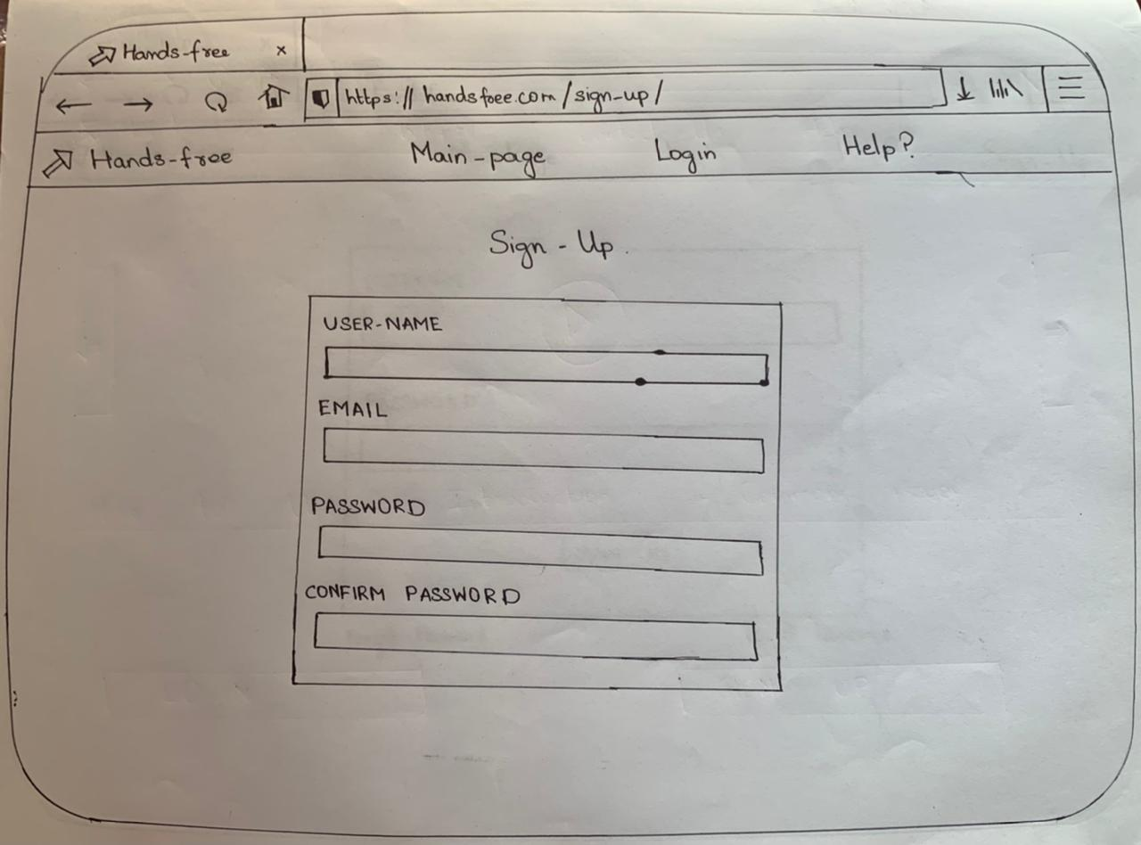

Slide 9
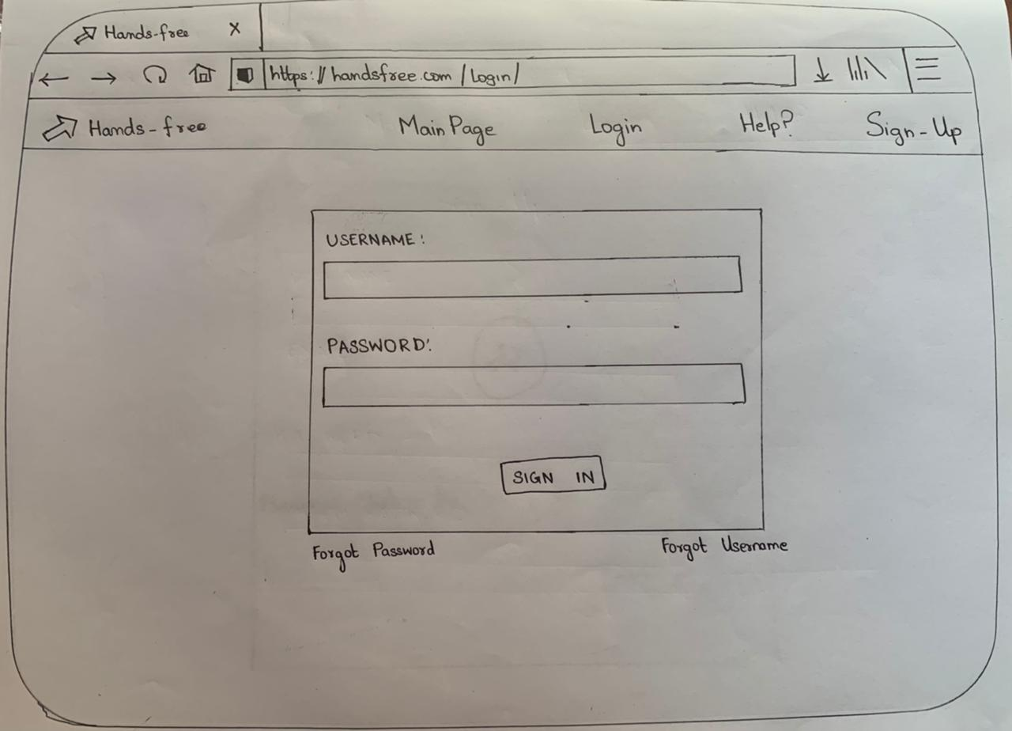

Slide 10
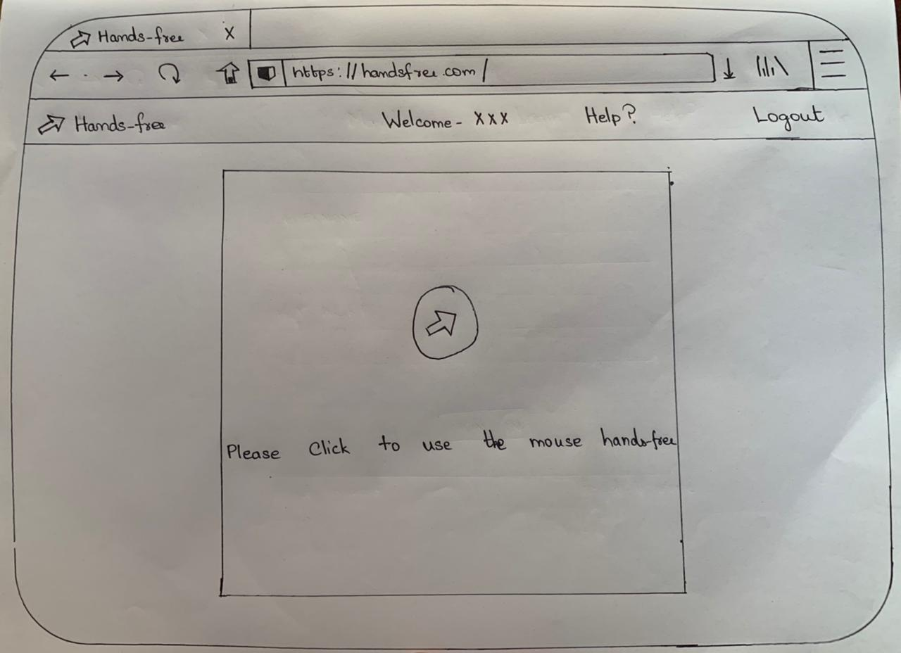

Slide 11
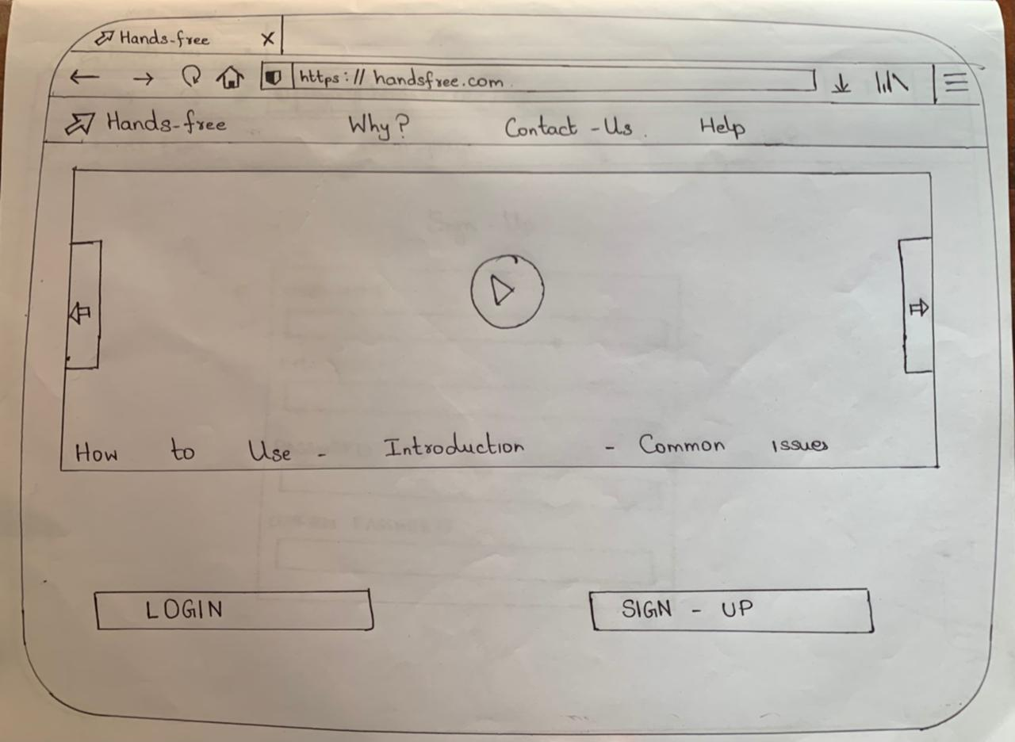

Slide 12
Heuristic Evaluation

Slide 13
Get accustomed to user’s Speed
With the continuous use of the application, the application must get used to the speed of the head movement. Much like how Google’s voice recognition system gets used and recognises the different speed and styles of speech, this application must also get used to the movement of the user’s head speed

Slide 14
Reduce Errors (Error Handling)
The application must see to that the errors made by must be autocorrected i.e the system must find out jerky movements made by the head and must try to and try wait for the user to make their correction. Also a few popups can can be shown that helps the user to make corrections to the particular movement. The application must recognise when the user might have made an error by recognising sudden change in movement .

Slide 15
Consistency
Consistent sequence of responses must be provided by the application for varying kind of actions. The application must learn from previous situations and must be able to accustom and provide the response that the user always expects.

Slide 16
Feedback Mechanism
A feedback mechanism should be setup.
The user must always know where the mouse pointer is presently and gesture is currently being recognised. It must be able to give signs when the mouse pointer gets left clicked and right clicked and the appropriate actions must be taken.
By the system at the end of each user’s usage of the system so that the user can understand how they can use the system better.

Slide 17
Provide a mechanism to reverse actions
The user must also be able to undo his/ her actions so that they can go back to where they they started. They must be able to access this feature directly using another key shortcut via gestures. This helps the user to go back to the previous step so that they can perform the action that they desire

Slide 18
Provide Shortcut Gestures
The user can be able to set a sequence of a common set of actions that could be performed upon the recognition of certain gestures. This can help the users a lot as a single gesture can help achieve a set of tasks that would be very time consuming when using a mouse. This

Slide 19
Customisable Gestures
The user must have a feel of control over the system. So the Gestures in the Application can be easily changed by the user and can be highly customisable as pre the user’s needs. This would be very helpful since the user can get accustomed(i.e bu\y altering the gestures according to their needs) to the system even if the gestures in the initial system may not be friendly to that particular user.

Slide 20
Design Popups
The Application must show what action is currently being performed so the user must have a idea of what action is currently being performed. For this a popup will be setup so that it always shows the user what action is currently taken.

Slide 21
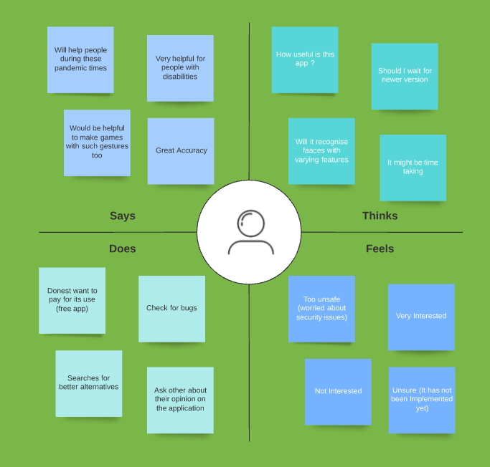
Empathy Map
A few people in our surroundings were shown the app and a few responses of the users were embedded into this empathy map as shown here

Slide 22
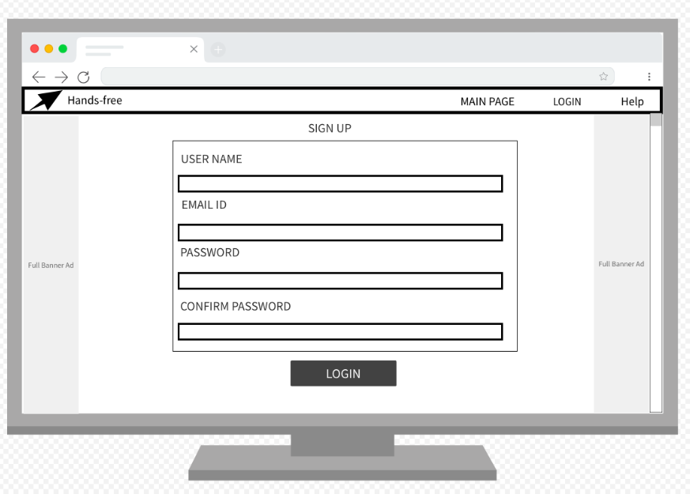
High Fidelity Prototype

Slide 23
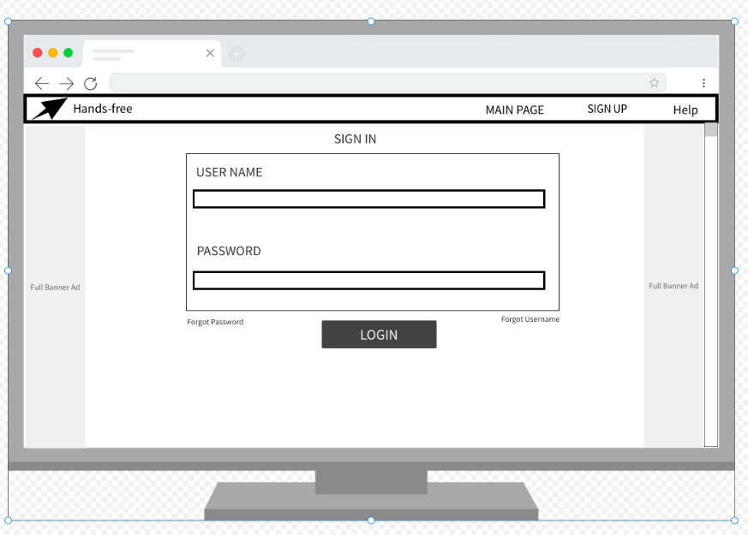

Slide 24
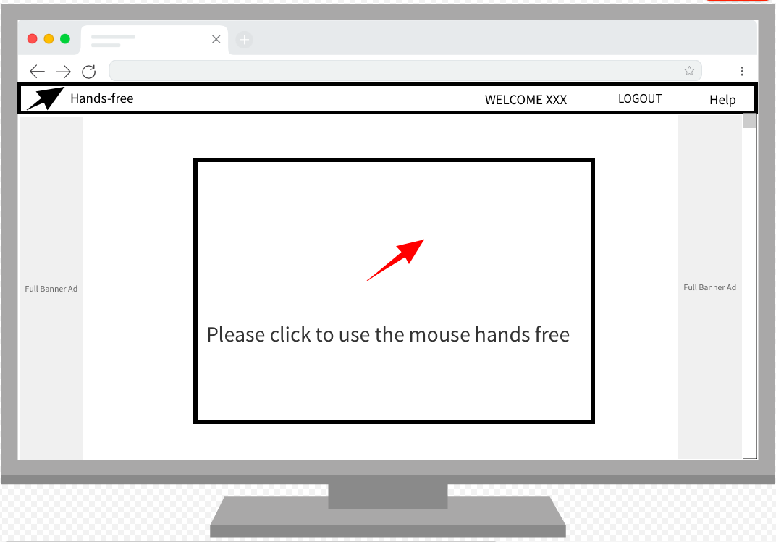

Slide 25
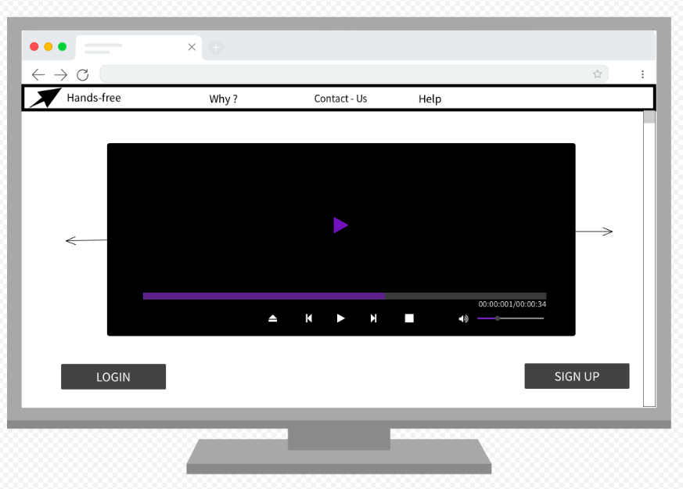

Slide 26
Thank You

